Slide 1
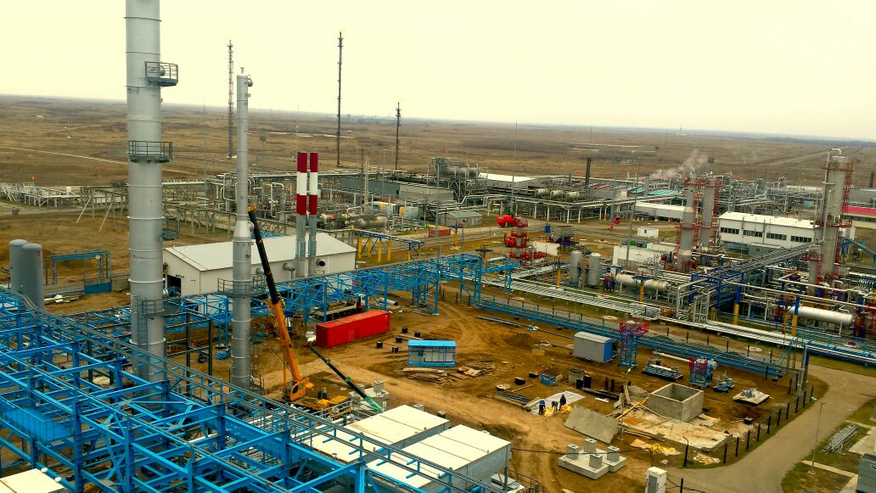
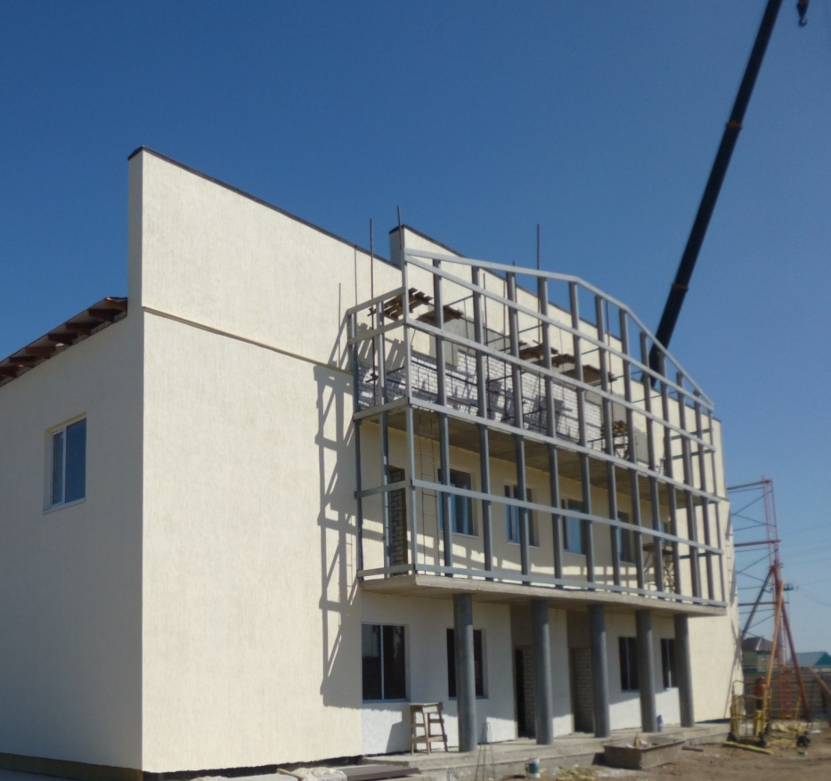
Zhana Consulting LTD Limited Liability Company

Slide 2
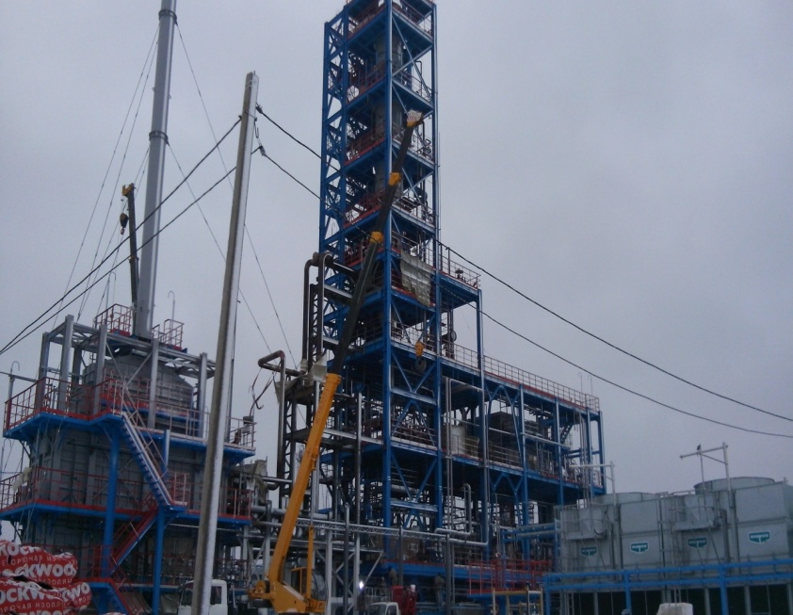
About the company Zhana Consulting LTD LLP
The strategic goal is the formation of Zhana Consulting LTD LLP as a leader among innovative companies in Kazakhstan, by mastering new technologies, diversifying the types of activities, ensuring the fulfillment of obligations.
Zhana Consulting LTD LLP today -
is an actively developing company and
a reliable partner of many Kazakhstani organizations.
Mission

Slide 3
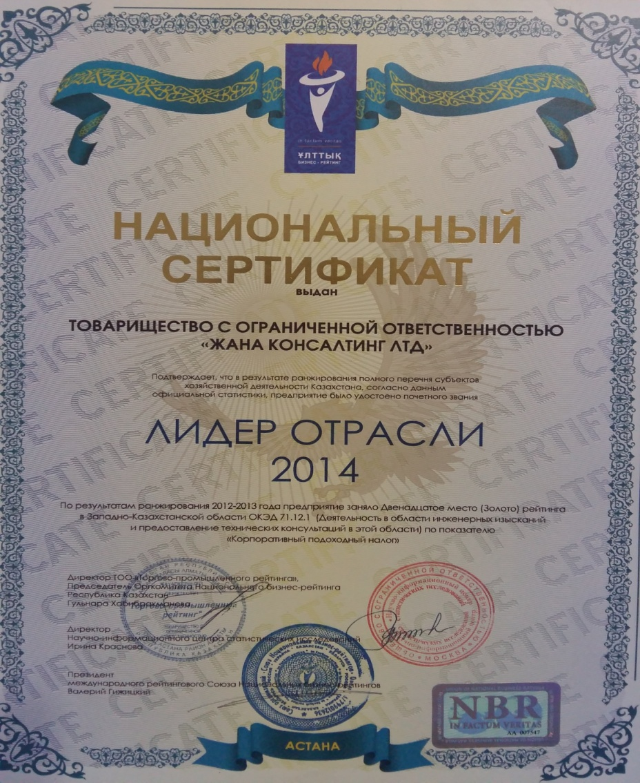
About the company Zhana Consulting LTD LLP
10 years of successful experience in the engineering services market for technical supervision
The turnover of the company is 188 million tenge
State licenses:
- Certificate of state registration
- Project Activities
- Exploration activities
- Certificate of accreditation of the second and the first level
responsibility

Slide 4
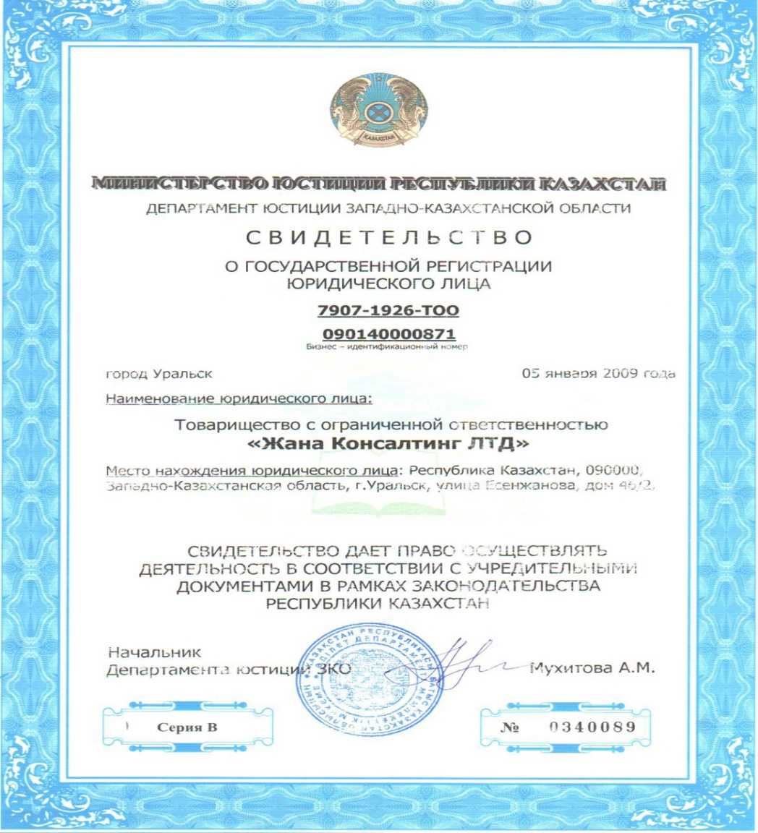
About the company Zhana Consulting LTD LLP
Zhana Consulting LTD LLP was founded in 2008 and became one of the leading organizations that provide engineering services for technical supervision on technically and technologically complex facilities of the first level of responsibility.
10 years on the Kazakhstan market did not pass without a trace for Zhana Consulting LTD" LLP. High quality of work, carried out at the set time, allows to form a constantly updated portfolio of orders. Successful participation in major projects has made this line of activity of Zhana Consulting LTD LLP a priority.

Slide 5
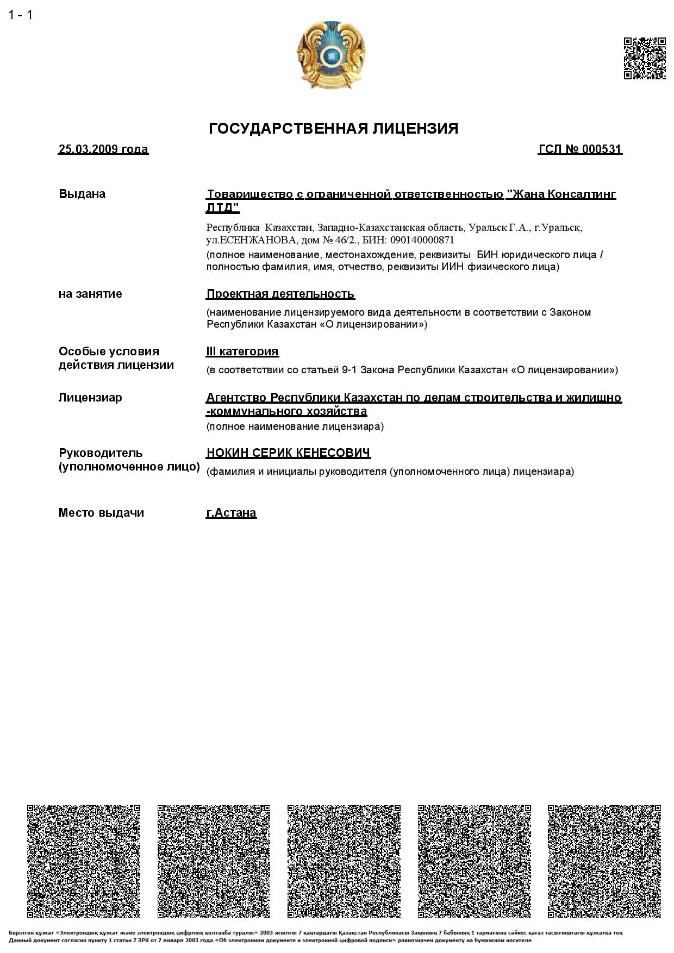
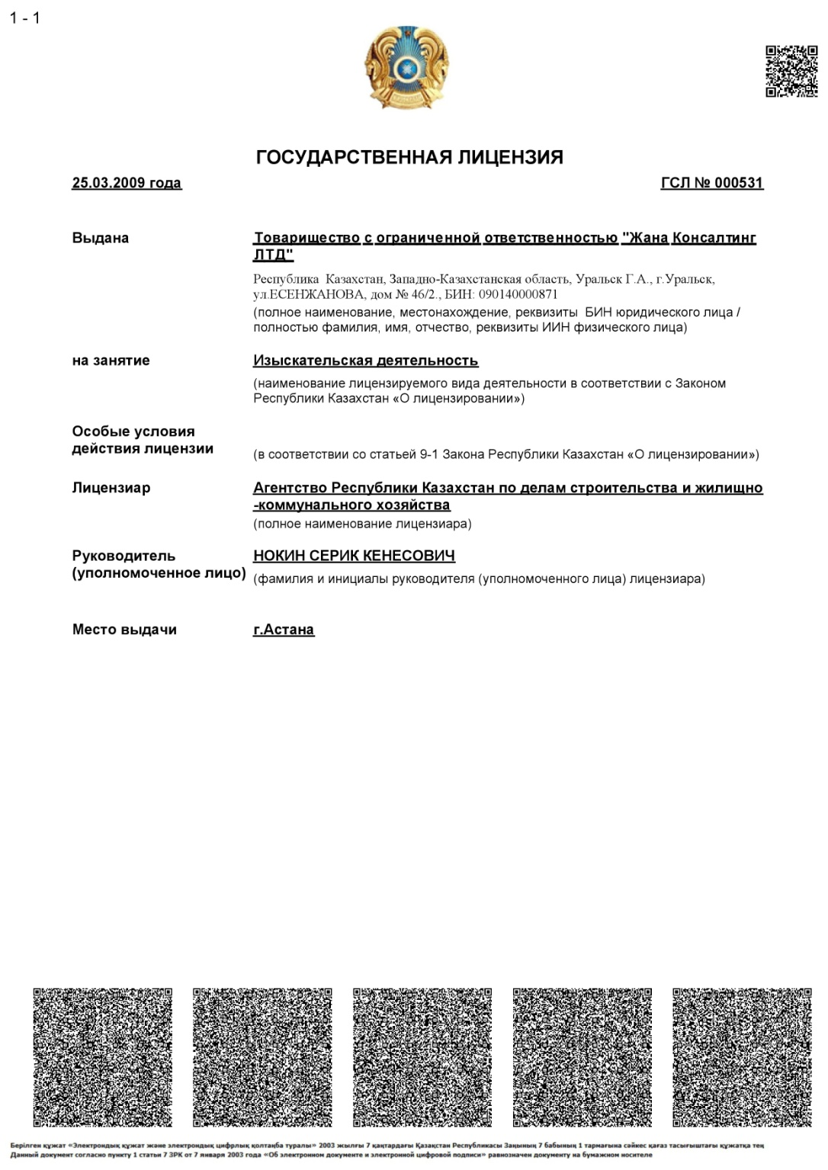
About the company Zhana Consulting LTD LLP

Slide 6
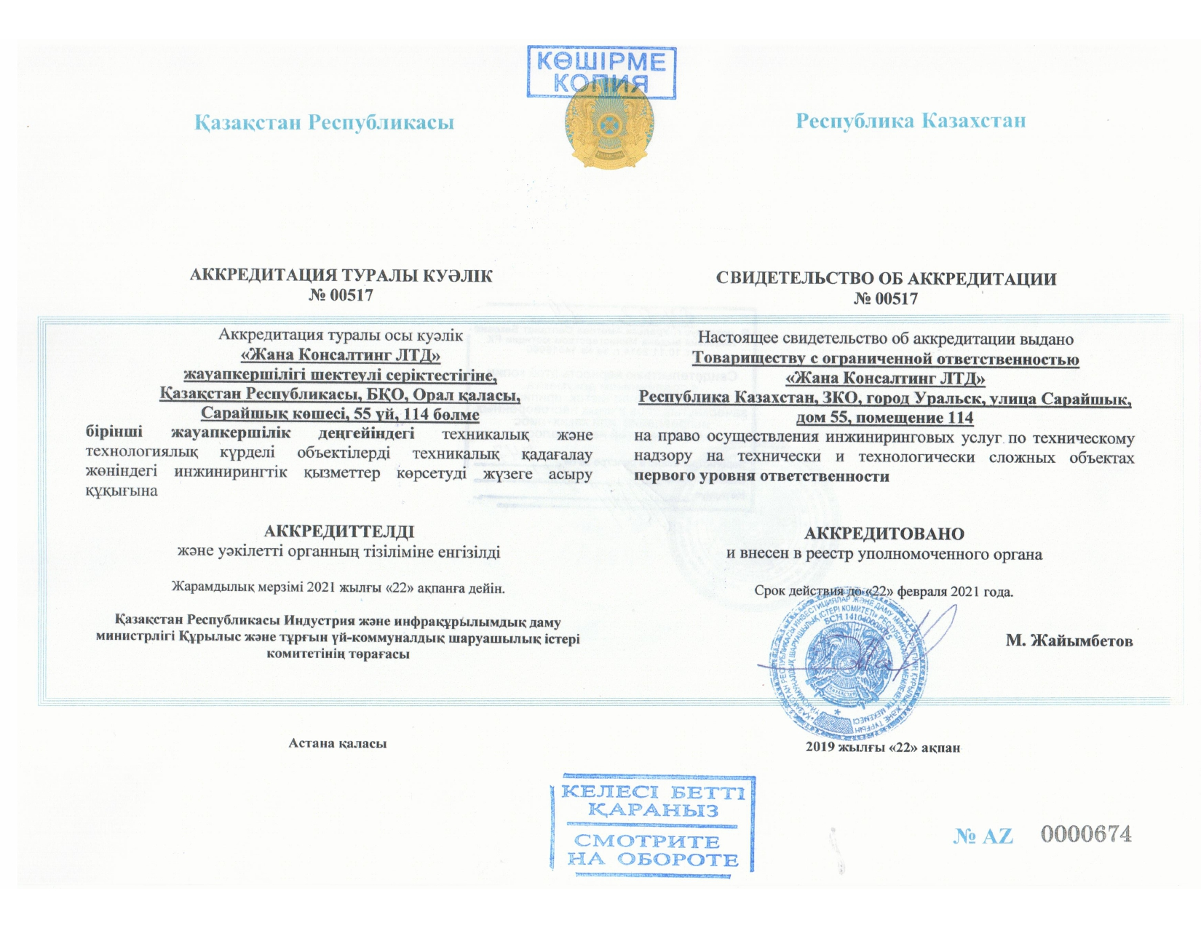
About the company Zhana Consulting LTD LLP

Slide 7
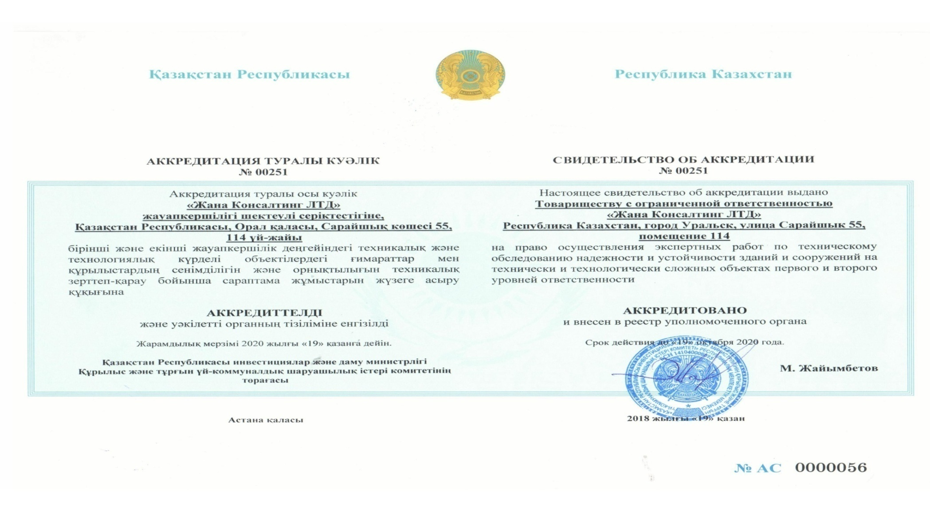
About the company Zhana Consulting LTD LLP

Slide 8
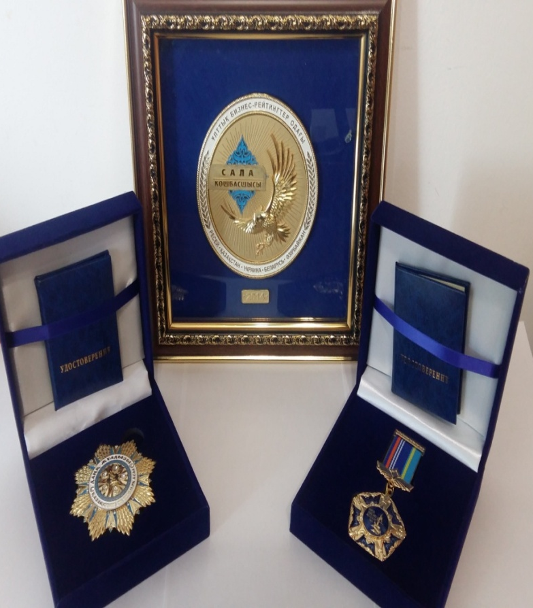
About the company Zhana Consulting LTD LLP
COMPANY CERTIFIED BY SYSTEM MANAGEMENT
Certificate of Quality ISO 9001-2016
Certificate of Environmental ISO 14001-2016
Certificate of Health and Safety OHSAS 18001-2008
In 2014 THE COMPANY AWARDED by :
National certificate "Leader of the industry in 2014"
Order "The Star of Glory: The Economy of Kazakhstan"
Medal "For merits and achievements"

Slide 9
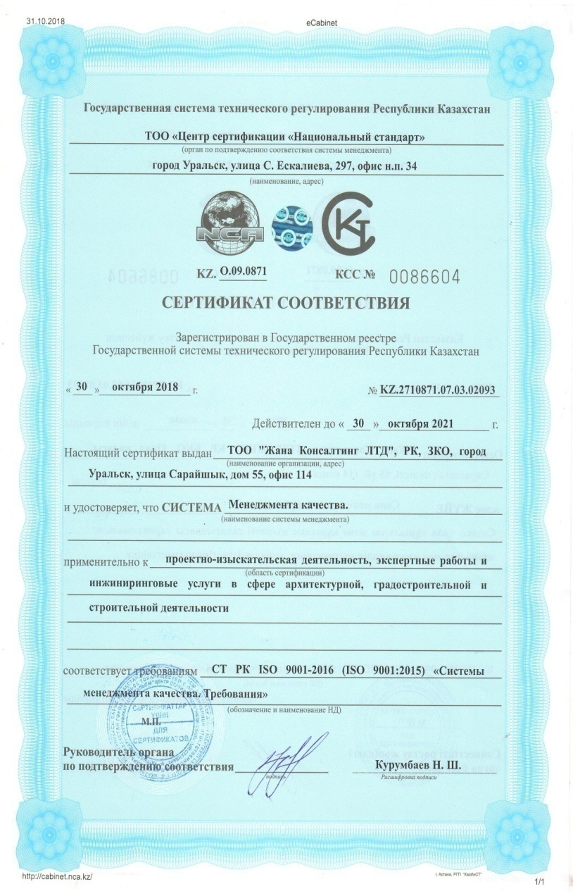
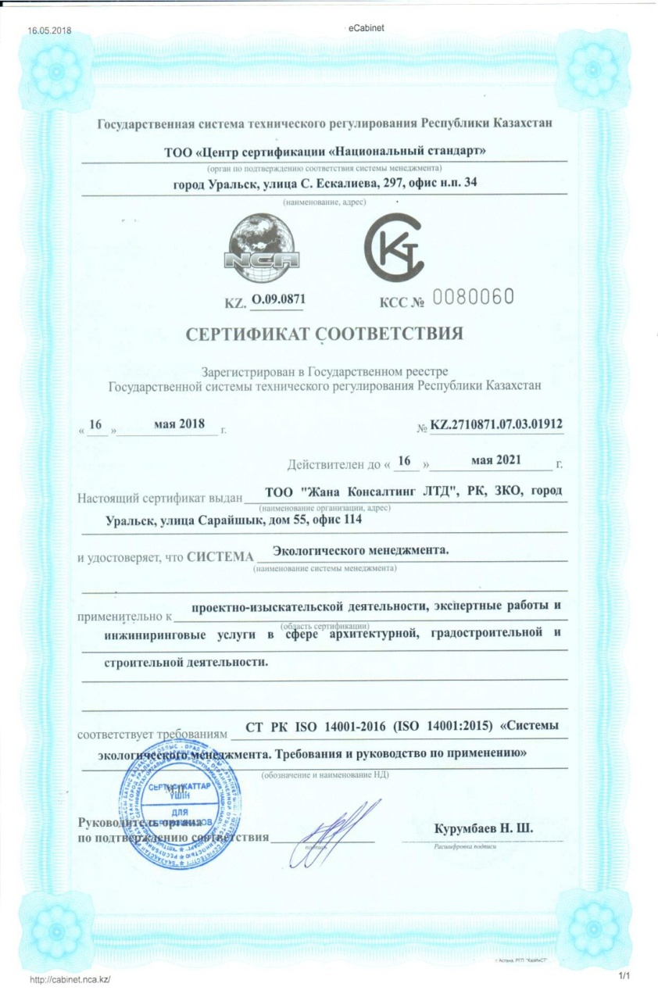
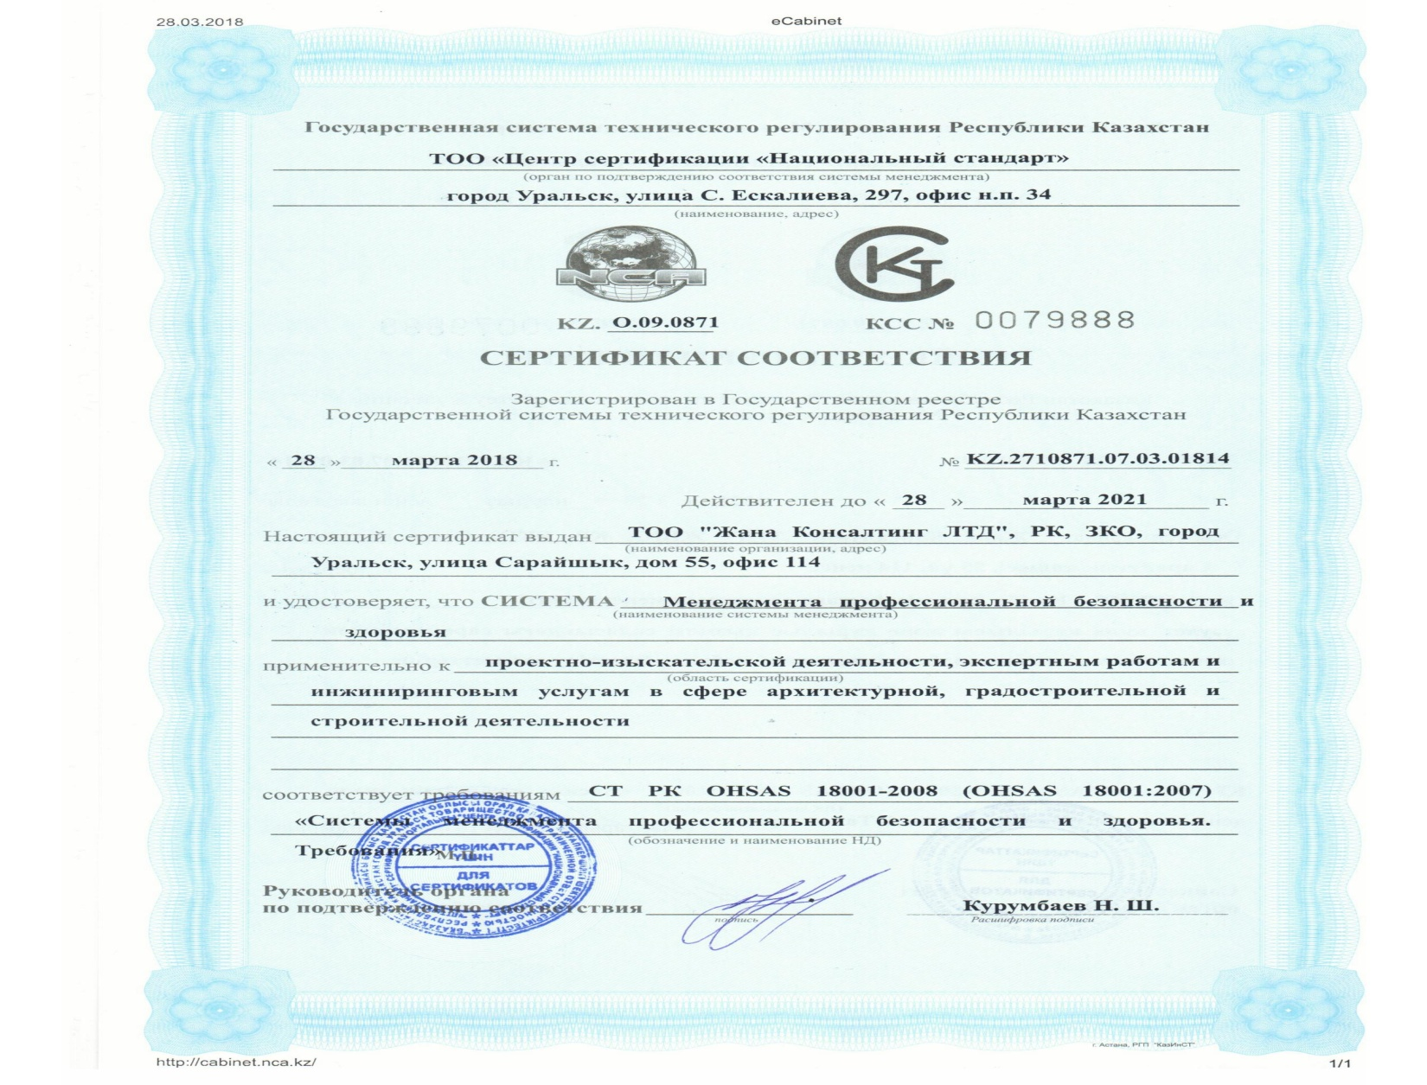
About the company Zhana Consulting LTD LLP

Slide 10
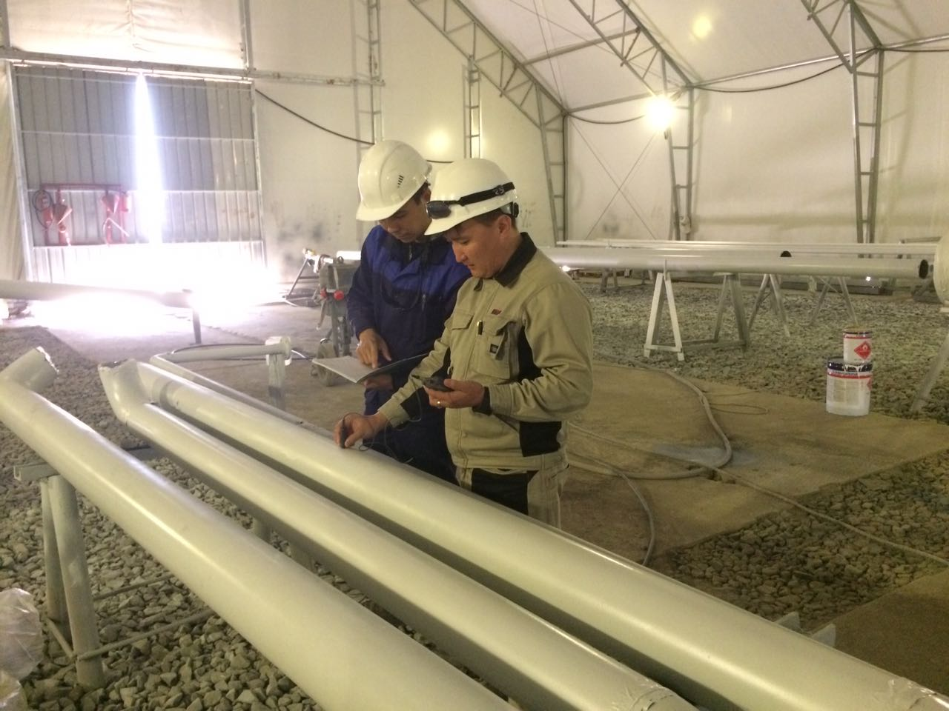
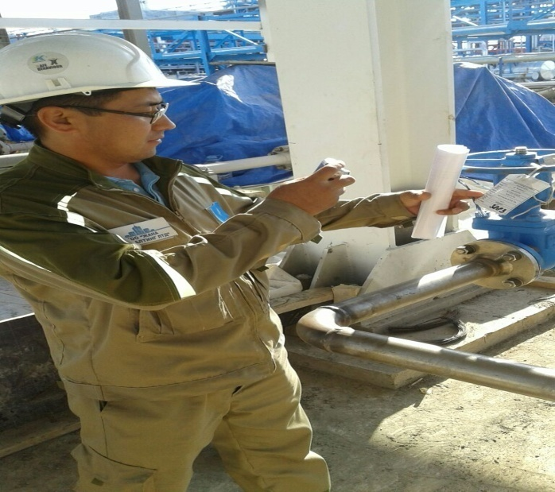
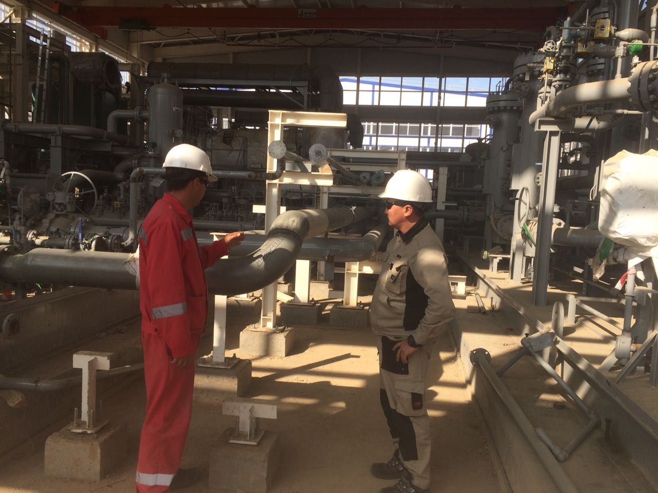
About the company Zhana Consulting LTD LLP
30 qualified specialists
The priority of our company's work is a highly
professional attitude, supported by knowledge and
big experience of employees in different regions, with different climatic conditions, strict labor discipline, strict compliance with the requirements of normative and technical and design documentation.

Slide 11
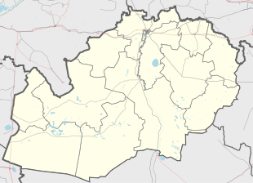
About the company Zhana Consulting LTD LLP
More than 100 successfully implemented projects
Chinarevo
Taskala
Аksai
Peremetnoye
Podstepnoe
Uralsk
Zhympity
Kaztalovka
Chapaevo
Zhangala
Karatobe
Saikhin
Atyrau

Slide 12
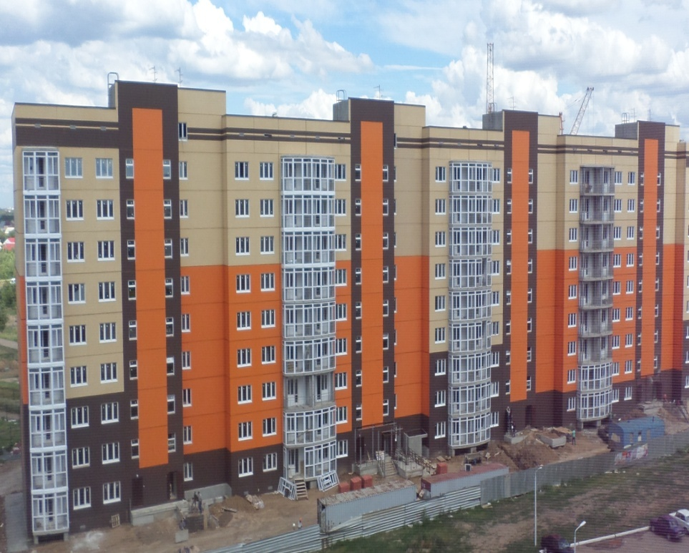
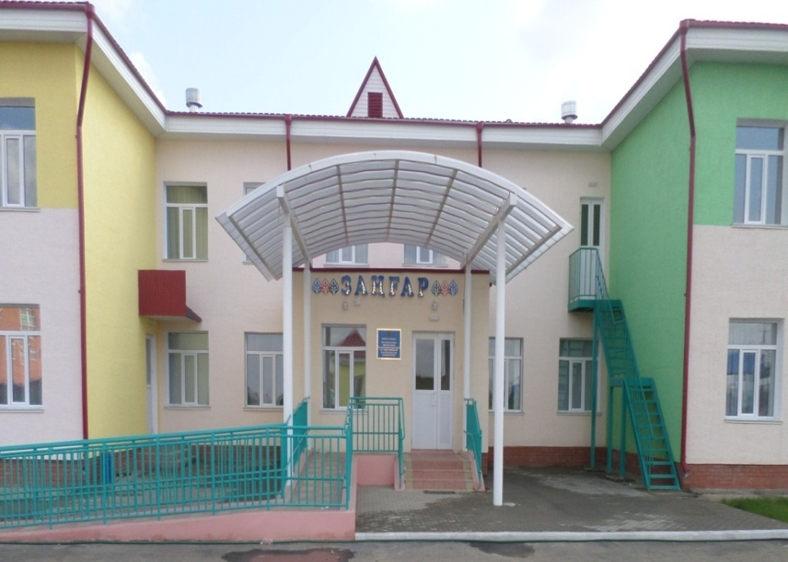
About the company Zhana Consulting LTD LLP
Having a well-organized internal structure the company
does not allow delays in performance of works and inconsistencies in the actions of their employees.
The demand and quality of services of Zhana Consulting LTD LLP is confirmed by its active cooperation with state organizations.
The company takes a direct part in the implementation of such state programs as:
Development of Regions;
Capital repairs of roads;
Gasification of settlements;
Nurly Zher;
100 schools, 100 hospitals;
Employment road map 2020;
Affordable housing-2020;
The state program of infrastructural development
"Nurly Zhol“ for 2015-2019.

Slide 13
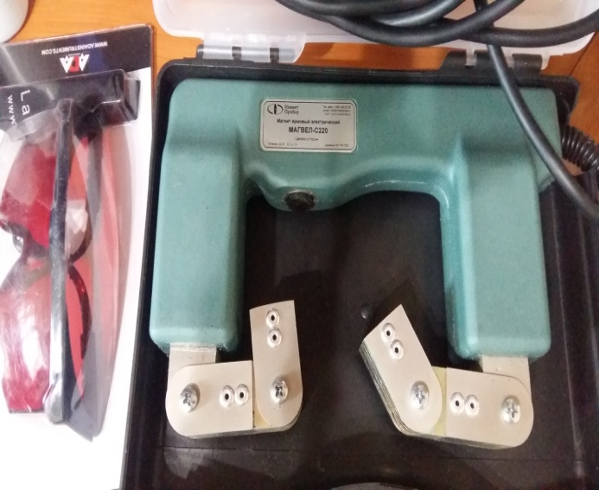
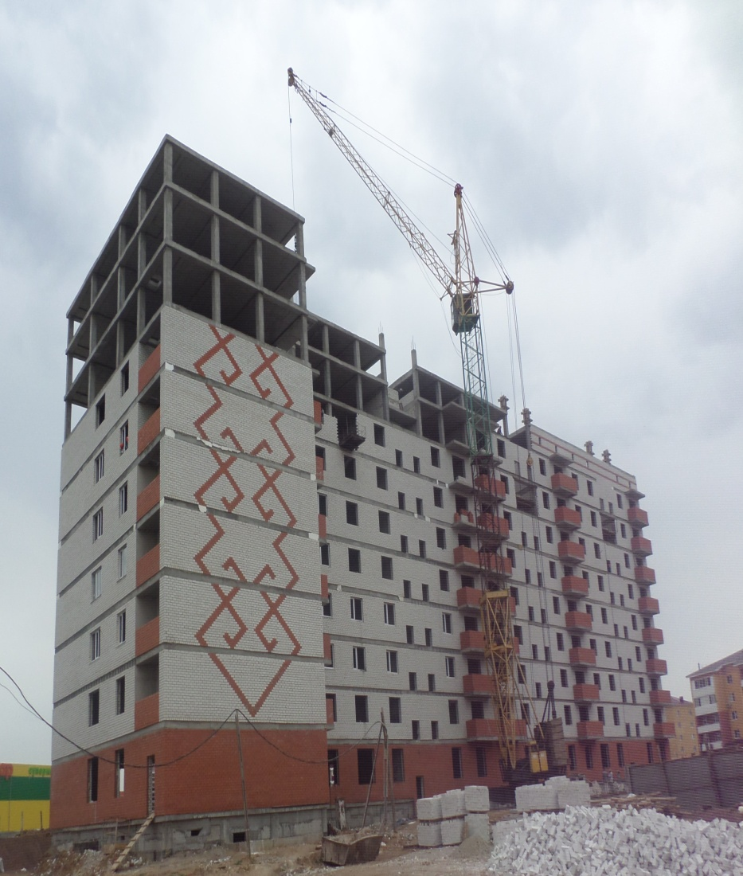
Our services
- Engineering services for independent technical supervision
on technically and technologically complex objects
- Design
- Geology
- Services of the testing laboratory for
non-destructive control and geology of Zhana Consulting LTD LLP
- Technical inspection of buildings and structures
The scope of our services is incredibly wide, but we can guarantee the utmost thoroughness of work on each of these industries.
Behind each of these items are hidden teams of professionals who have behind their shoulders many years of experience in the field of data services

Slide 14
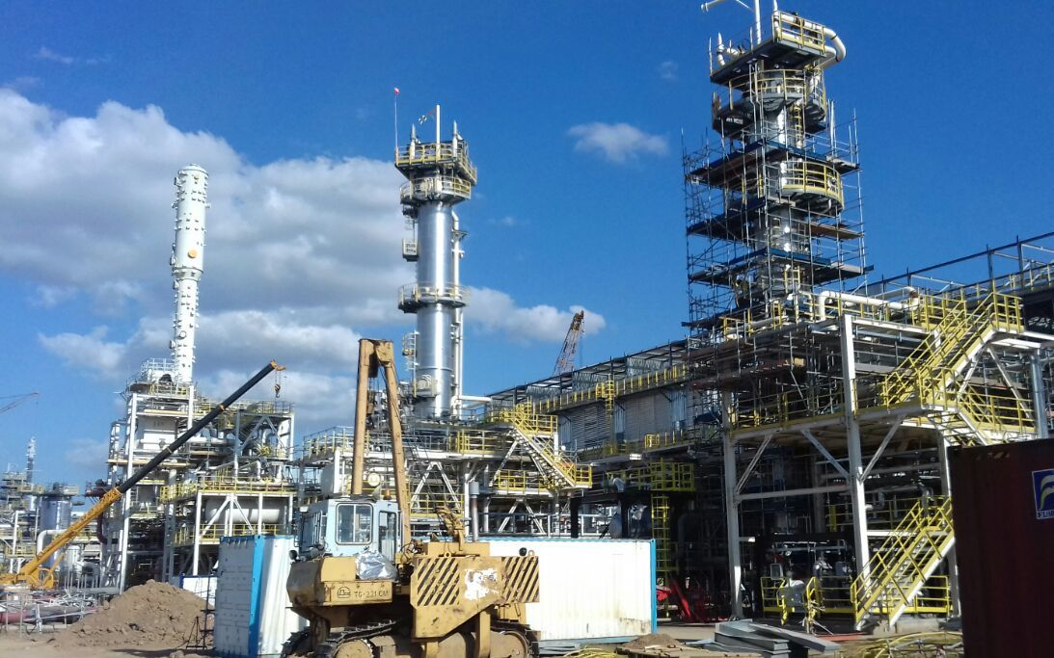
Engineering services for technical supervision
In January 24, 2017, Zhana Consulting LTD LLP received a new Certificate of accreditation for the right to carry out engineering services for technical supervision on technically and technologically complex facilities of the first level of responsibility. Technical supervision is carried out for the construction of industrial and civil buildings and facilities, as well as supervision of the construction of roads and bridges.
Our company has highly qualified specialists, own motor transport and all the necessary modern equipment for technical supervision.
Perfection of performance and guaranteed reliability is the main quality of our work

Slide 15
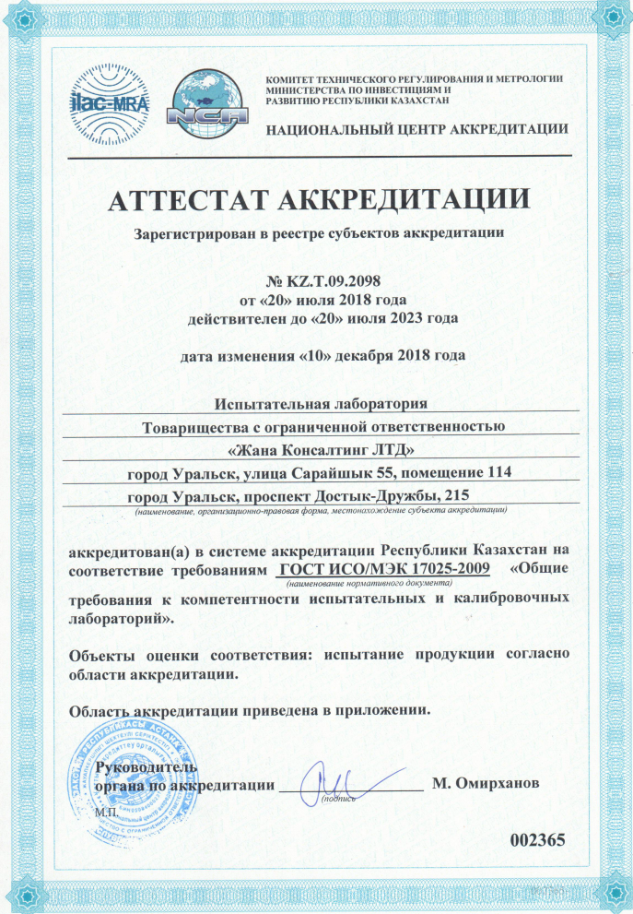
Testing laboratory for non-destructive control Zhana Consulting LTD LLP
The laboratory of Zhana Consulting LTD LLP
is accredited in the accreditation system of
the Republic of Kazakhstan for compliance with the requirements of standard ISO/IEC 17025.
Specialists of the testing laboratory of Zhana Consulting LTD LLP passed certification in specialized, accredited training centers such as Batys Ondyrys-Kurylys Service LLP, Tenyz Arystany LLP, Certification Center for Nondestructive Testing PA, National center of expertise and certification RoK WKB JSC, have high qualifications and considerable experience in the requirements of standards applied in the Republic of Kazakhstan.

Slide 16
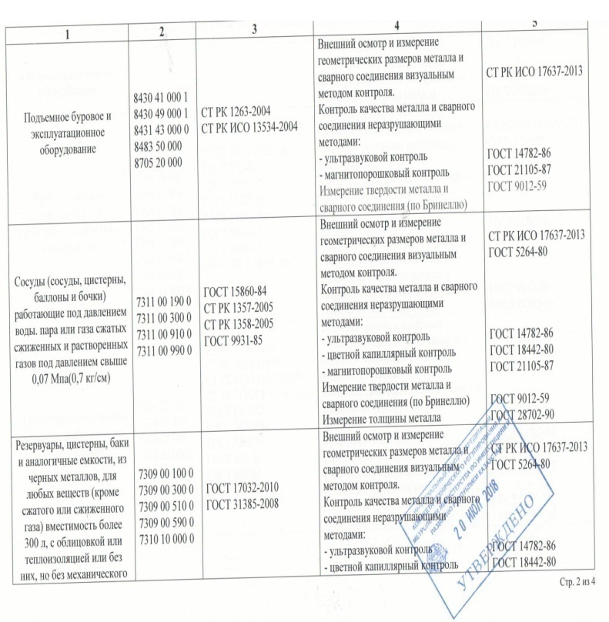
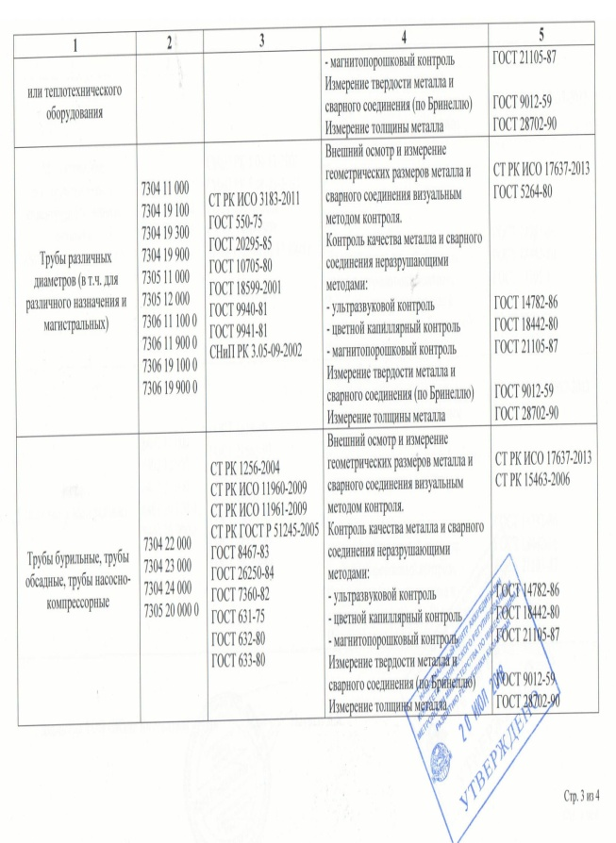
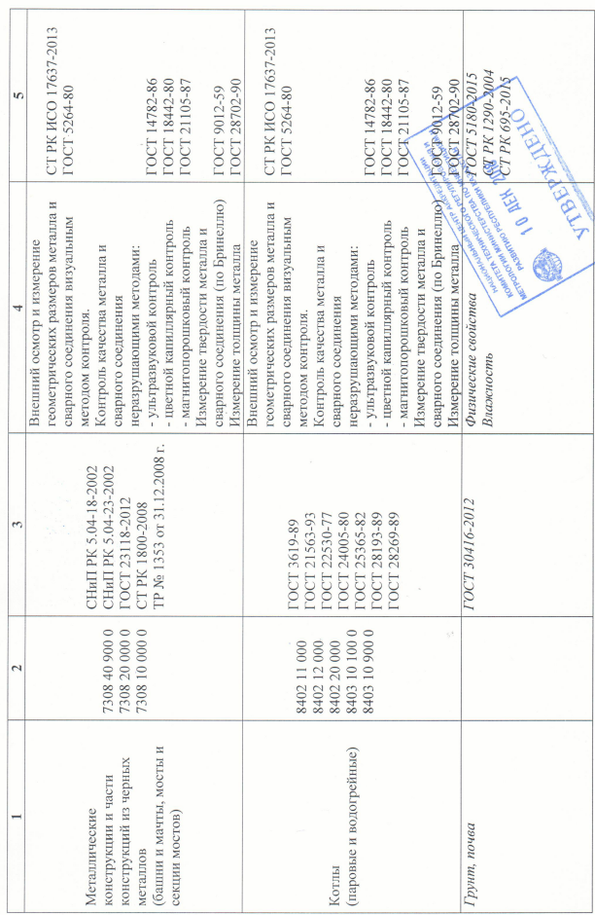
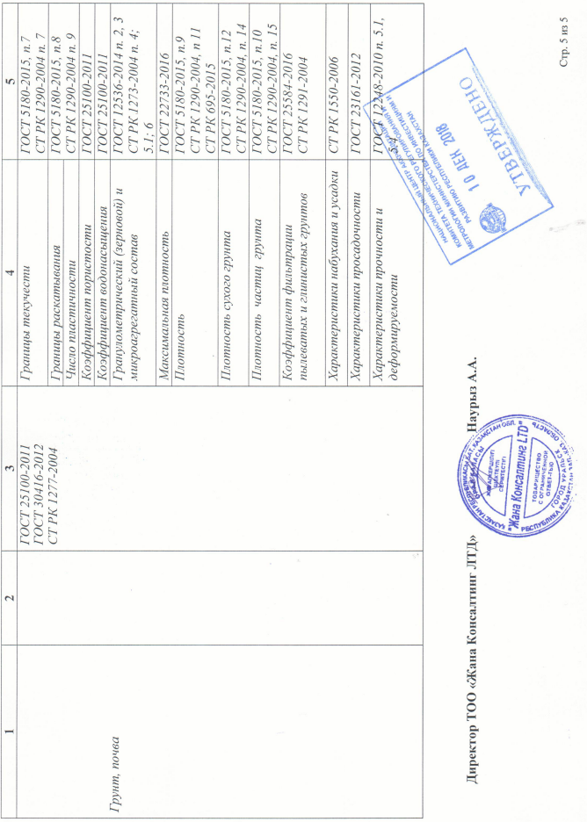
Testing laboratory for non-destructive control Zhana Consulting LTD LLP
Accreditation provides consumers with a guarantee of the appropriate quality of services for testing and ensuring the accuracy of measurements.

Slide 17
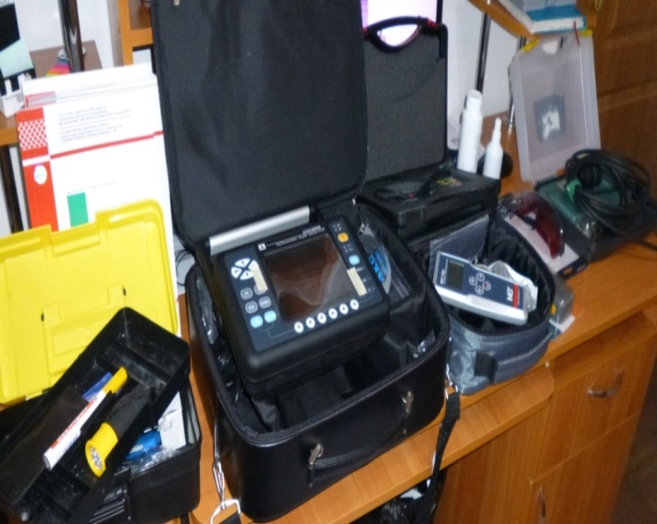
Testing laboratory for non-destructive control Zhana Consulting LTD LLP
The main purpose of the testing laboratory for non-destructive testing of Zhana Consulting LTD LLP is to conduct on-site diagnostic and inspection work in the construction, operation and repair of main pipelines, commercial reservoirs and other gas, oil refining, construction and other industries.
The testing laboratory has a rich material and regulatory base, is provided with a full production facility, modern equipment, which are annually tested and calibrated, with consumables for a full range of tests.

Slide 18
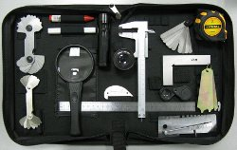
Testing laboratory for non-destructive control Zhana Consulting LTD LLP
The testing laboratory conducts certification testing of products in accordance with the areas of laboratory accreditation using the following methods of nondestructive testing:
The testing laboratory for non-destructive testing conducts the following studies:
VT - visual and measuring control;
UT - Ultrasonic flaw detection and thickness measurement;
PT - penetrating substances;
MT - magnetic particle inspection;
Measuring the hardness of the method of Rockwell, Brinell, Vickers.

Slide 19
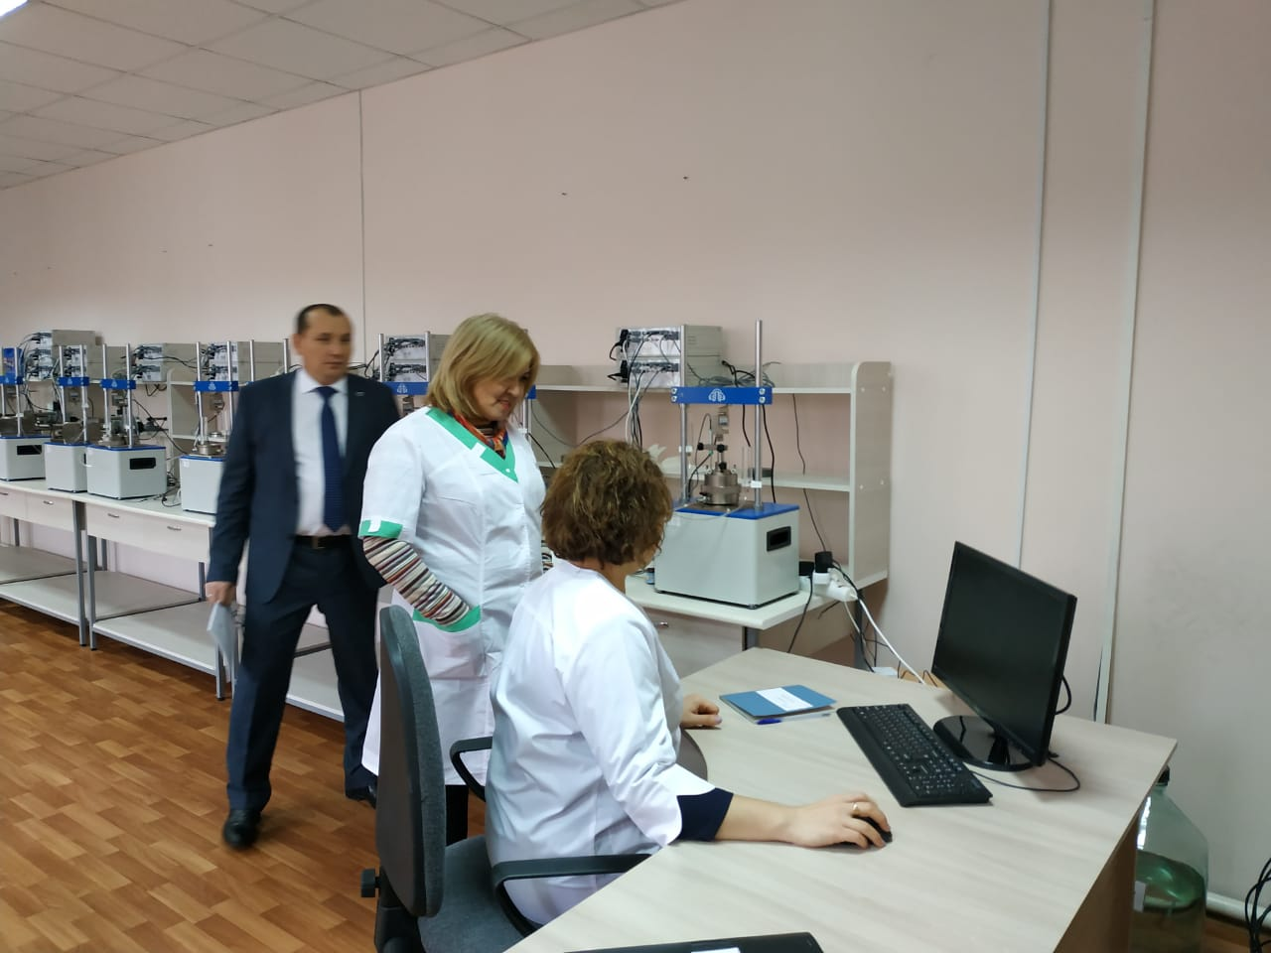
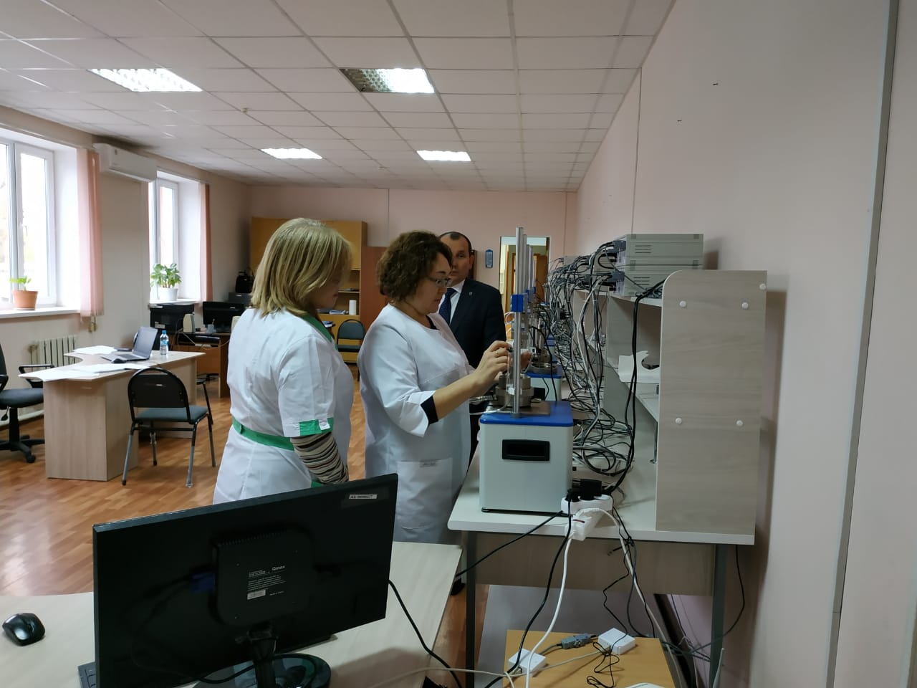
Testing laboratory for geology “Zhana Consulting LTD” LLP
Laboratory testing of soils are produced in an accredited testing laboratory.
In the composition of engineering-geological surveys are carried out laboratory, geological studies of the physical and mechanical properties of soils, in compression and shear devices, in devices of three-axis compression.
As a result of laboratory research, the title, composition, condition, physical and mechanical properties of soils are determined. Geological studies of the soil are carried out in order to identify the properties of adhesion and deformations of the soil mass, to simulate the effect of the structure on the ground.

Slide 20
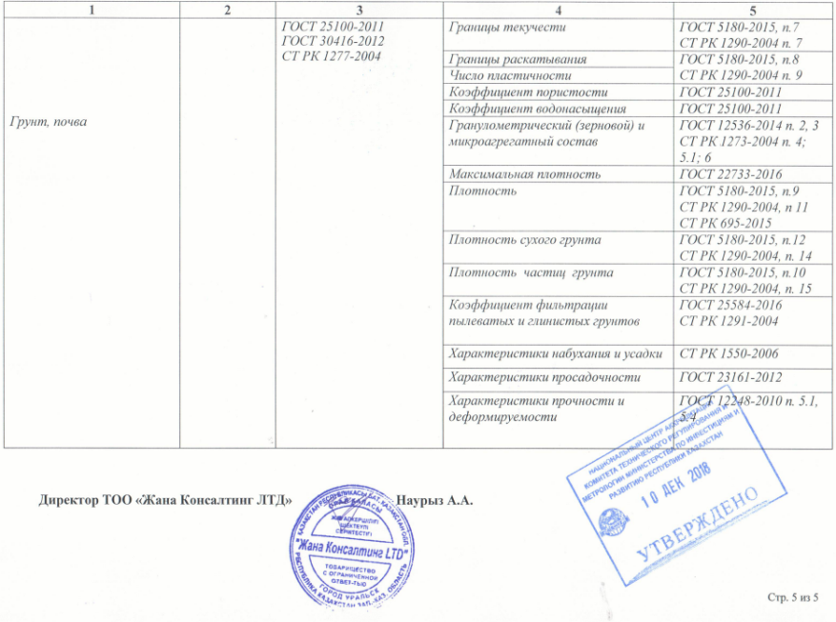
Testing laboratory for geology “Zhana Consulting LTD” LLP
The study of physical indicators of soil in the laboratory includes:
Determination of natural moisture;
Determination of soil density;
Determination of soil porosity;
Determination the plasticity number;
Determination of the humidity degree;
Determination of the turnover degree;
Ability of soil to shrink, swelling properties;
The type of soil is also determined.

Slide 21
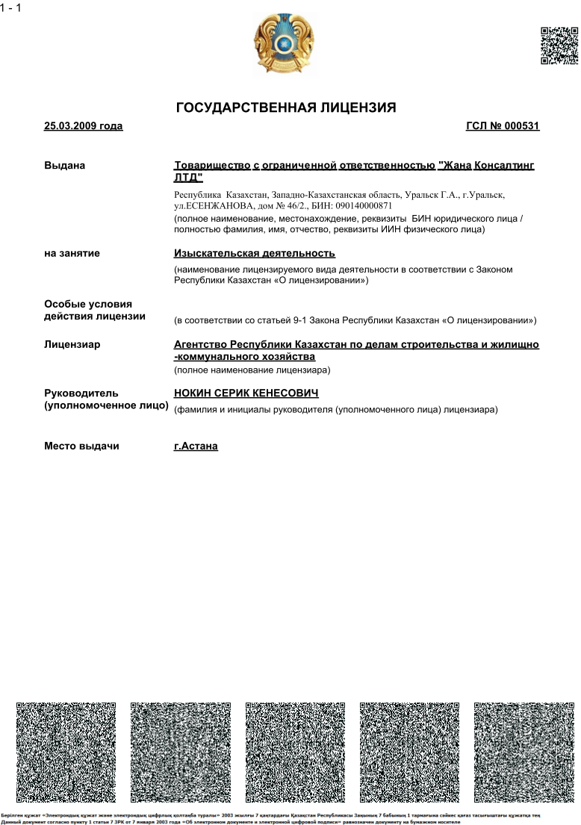
Survey activity
Licensed activity subspecies
Name of the subspecies of the licensed type of activity in accordance with the Law of the Republic of Kazakhstan "on licensing“:
Engineering-geological and engineering-hydrogeological works, including:
Field studies of soils, hydro geological studies;
Geophysical surveys, reconnaissance and survey
Engineering and geodetic works, including:
Topographical works for design and construction (surveys in scales from 1: 10,000 to 1: 200, as well as surveys of underground communications and facilities, tracing and surveying ground-based linear structures and their elements;
Geodetic works associated with the transfer to nature with reference to engineering-geological workings, geophysical and other survey points;
Construction and laying of geodesic centers;
The creation of planning and high-altitude shooting networks

Slide 22
Survey activity
Completed studies allow to solve such important tasks:
choose a right a place for construction that meets all standards and requirements;
determine the level of groundwater, calculate the depth at which it is necessary to drill wells or dig a pit;
select the type of future foundation, the conditions for its waterproofing, protection, construction of the drainage system;
develop a master plan for the entire area intended for the construction site, determine the location for the well or well;
consider the size, type of construction of the future construction object, select materials;
assessment of the potential impact of wells, sewer systems and other things on the environment.
Hydrogeological studies are carried out by specialists, special wells are drilled at the site, water samples are taken, and then the necessary analyzes are carried out by laboratory.

Slide 23
Technical inspection of buildings and structures
Inspection of buildings and structures is the engineering work to determine the carrying capacity of their components and structures, the state of engineering communications and the general technical condition. The survey results are documented in the form of a technical opinion with a description and photo fixation of defects, conclusions and recommendations for reinforcing structures.
Technical conclusion - documentation containing text and graphic materials, which are an objective report on the inspection of the building, conclusions on the technical condition of the building and its engineering systems, as well as recommendations for its further operation.
Inspection of buildings - the procedure for determining the technical condition of buildings and structures, as well as their supporting structures. Based on the results (actual values of the monitored parameters) of the survey, it is possible to assess the suitability of the object for further operation, reconstruction, or to determine the need for the restoration, strengthening or repair of building structures.
Technical inspection of a building or structure is carried out by experts of Zhana Consulting LTD LLP in three stages:
Stage 1 - preparation for the survey;
Stage 2 - preliminary (visual) examination;
Stage 3 - detailed (instrumental) examination.
Zhana Consulting LTD LLP - is the guarantor of your peace when it comes to the need to conduct a building construction survey.

Slide 24
Technical inspection of buildings and structures
The reasons for the engineering survey can be:
- the expiration of the normal operation, the lack of continuous maintenance of structures and structural elements in good condition, not compliance with the required temperature and humidity conditions in the premises, not timely maintenance of engineering equipment and technical systems;
- loss of the original properties of the structures of buildings and structures (physical deterioration);
- expiration of the previously completed technical opinion;
- detection of various types of defects and damage during maintenance and operation, reducing the carrying capacity;
- obvious deviations of structures (deflections of beams and slabs, vertical displacement of columns) from design positions, determined visually without the use of special devices;
- the results of natural disasters, accidents and fires;
- carrying out the reconstruction of the building in order to add an additional floor or attic, as well as a change in the functional change of the building associated with an increase in temporary operational loads;
- carrying out major repairs with the replacement of individual supporting structures, partitions, window and door fillings. In this case, it is necessary to compile a detailed map of defects and damage in order to establish the real cost of the repair;
- legalization of a building or structure, as well as extensions made without a specially designed project;
- lack of design and executive documentation.
Using tremendous experience, modern tools and technologies, we guarantee the quality and objectivity of all the technical inspection of the building.

Slide 25
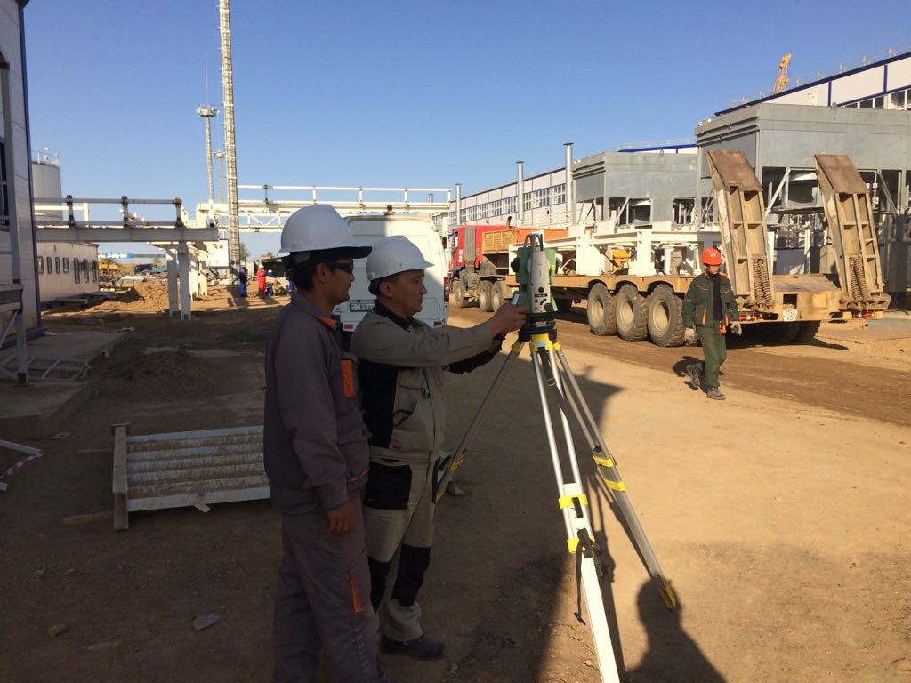
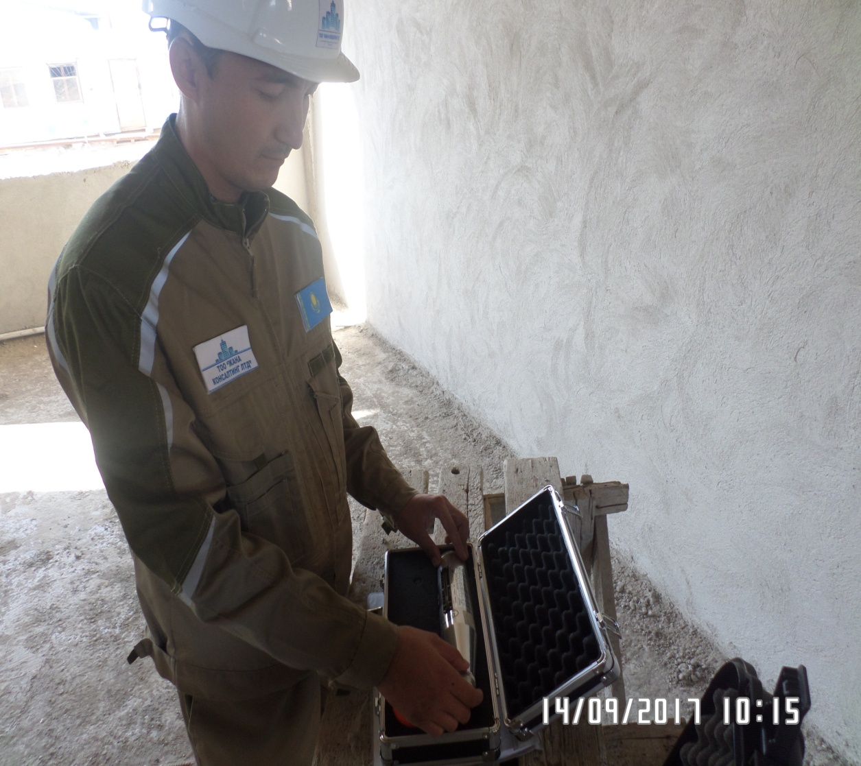
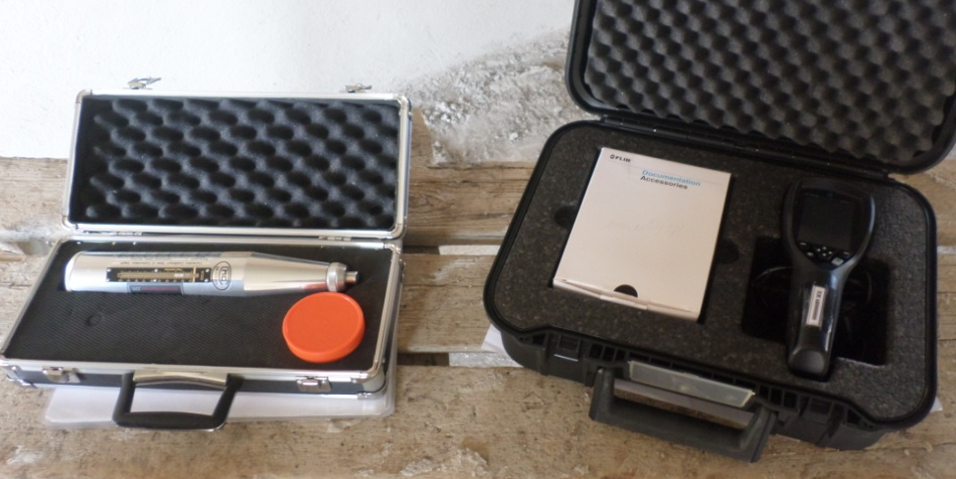
The company is equipped by modern equipment

Slide 26
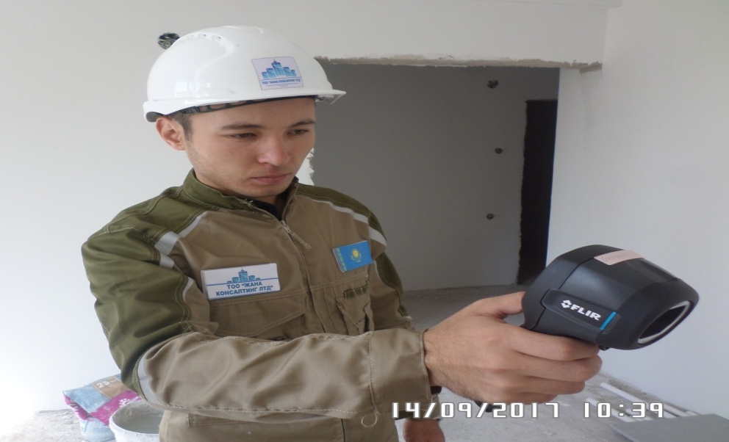
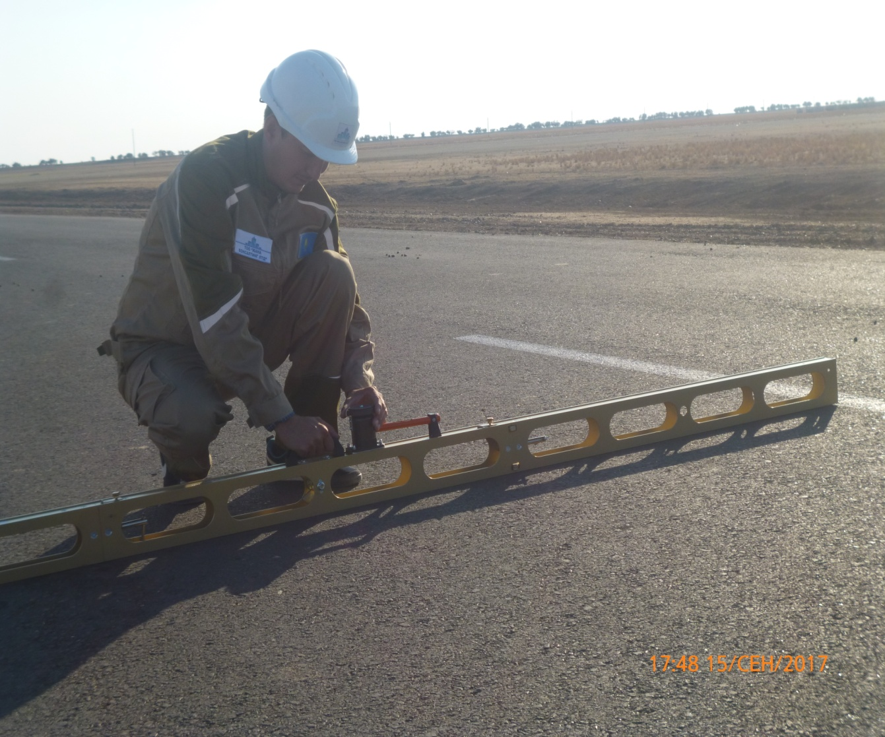
The company is equipped by modern equipment

Slide 27
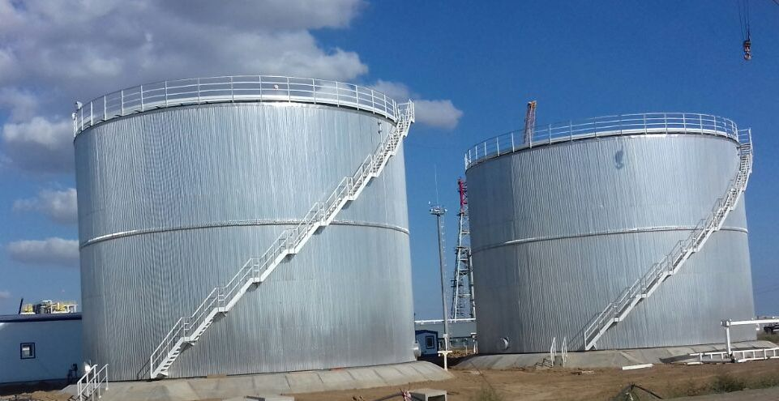
Experience in managing large project
High professionalism of the company is confirmed by successfully implemented projects, such as:
Objects for the production of components of gasoline of ecological class K5, Aksai, WKO
Intermediate tank farm of five reservoirs, Aksai, WKO
Technical Chemical Laboratory, Aksai, WKO
Vacuum distillation section, Aksai, WKO
Hydro treating section of diesel fuel components, Aksai, WKO
Modernization of the stabilization section and AT of a small-capacity plant for the production of fuels JSC "Condensate" to increase the processing of raw materials to 850 thousand tons per year
Installation of complex gas treatment (UKPG - 3), m. Chinarevskoye
New gas-turbine power station for 26, m. Chinarevskoye
Fuel gas supply system for electric stations power supply with capacity of 26 MW, m. Chinarevskoye
Construction of a kindergarten for 360 places in the village of Zachagansk, Uralsk, WKO
A complex of 10-9-storeyed houses site # 9 in the multi-storey buildings between the routes of Uralsk-Atyrau and Uralsk-Saratov, Uralsk, VKO
Bank protection in the village Oblivka, Burlinsky district, WKO
The slaughter shop along the Uralsk-Atyrau highway at the intersection of the Chapaevo-Zhangala road, WKO

Slide 28
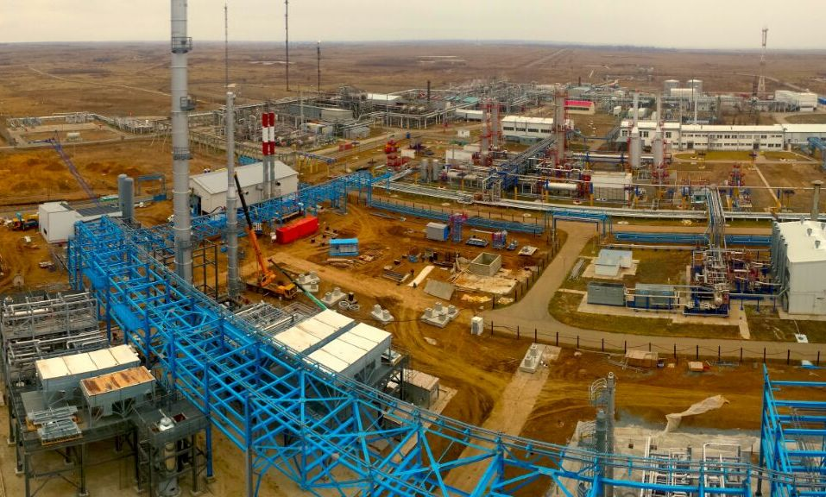
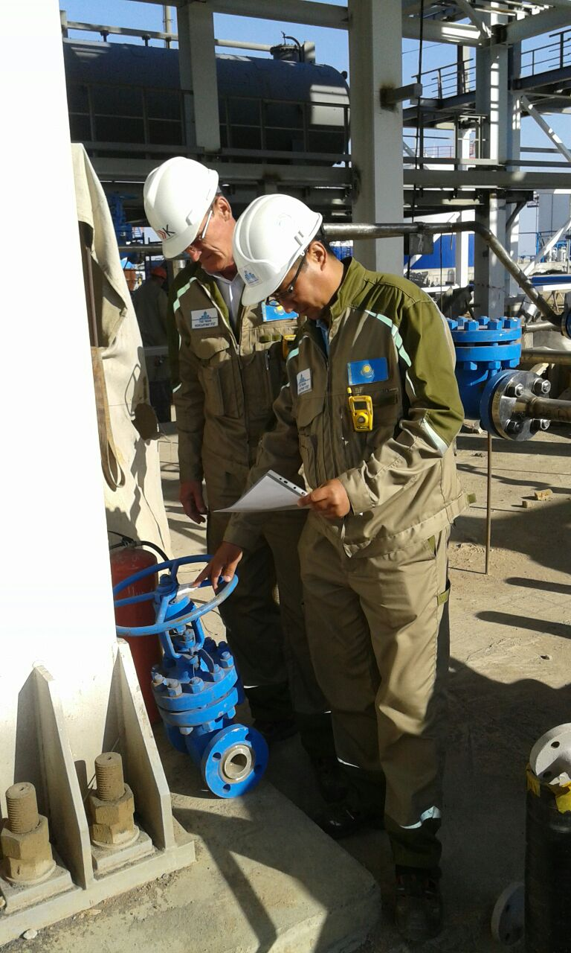
Experience in managing large projects
Objects for the production of components of gasoline of ecological class K5, Aksai, WKO

Slide 29
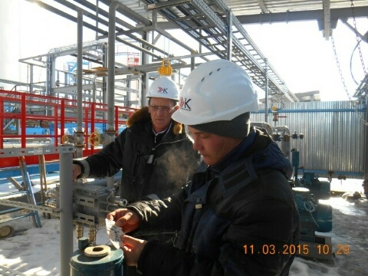
Experience in managing large projects
Vacuum distillation section, Aksai, WKO

Slide 30
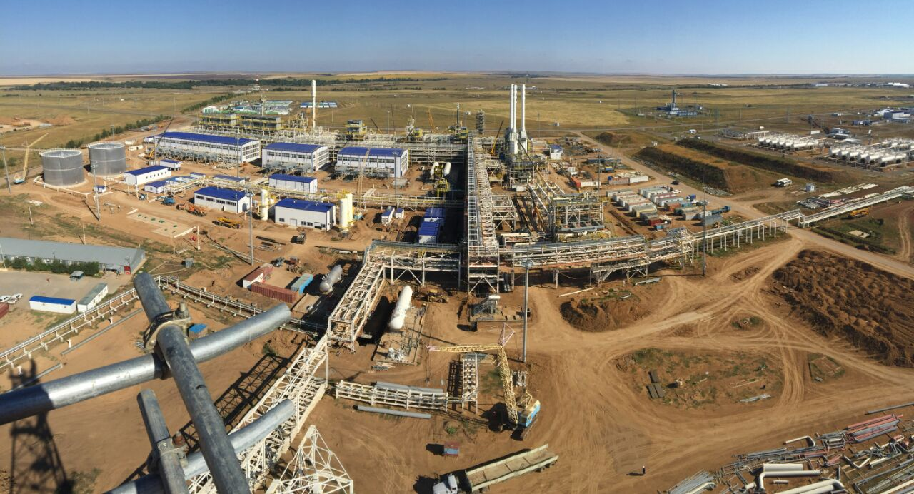
Experience in managing large projects
Installation of complex gas treatment (UKPG - 3), m. Chinarevskoye

Slide 31
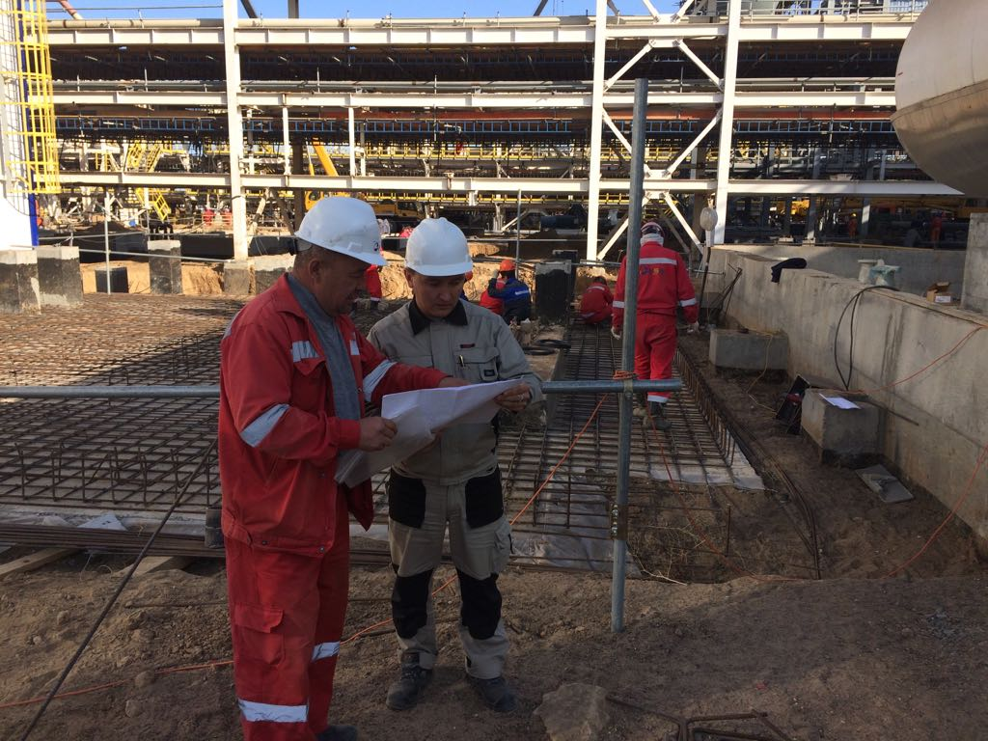
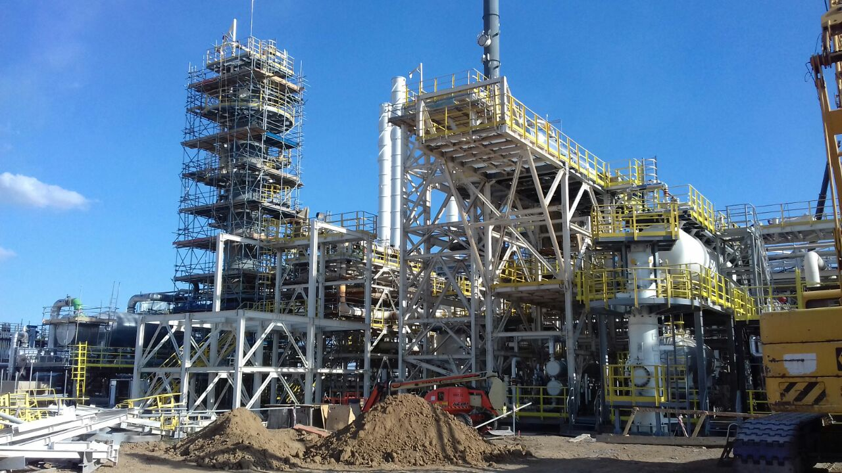
Experience in managing large projects
Installation of complex gas treatment (UKPG - 3), m. Chinarevskoye

Slide 32
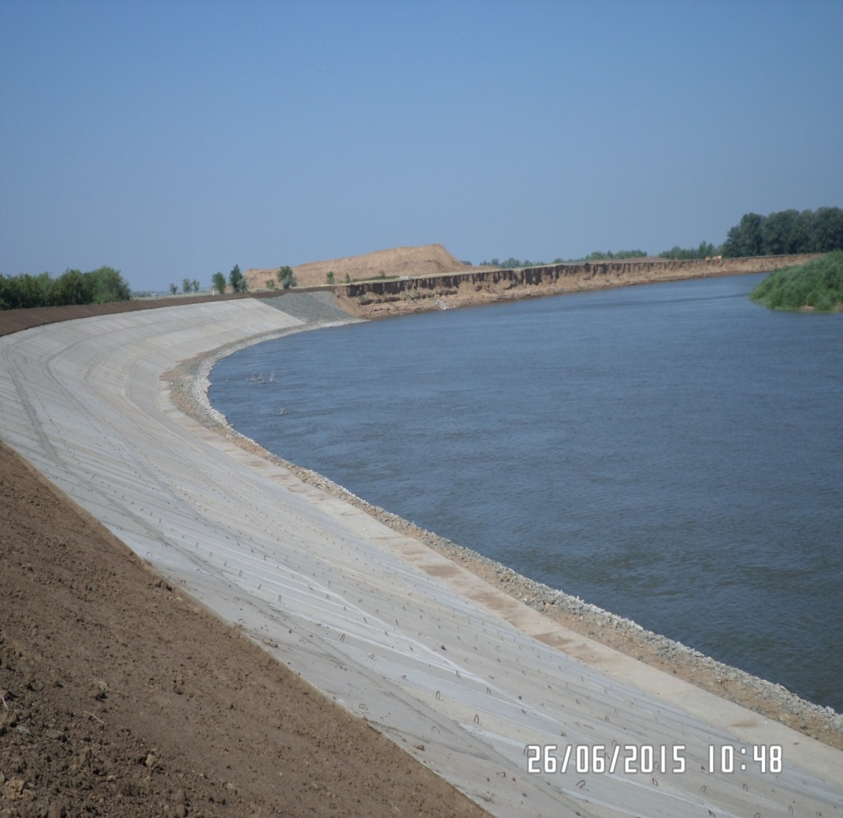
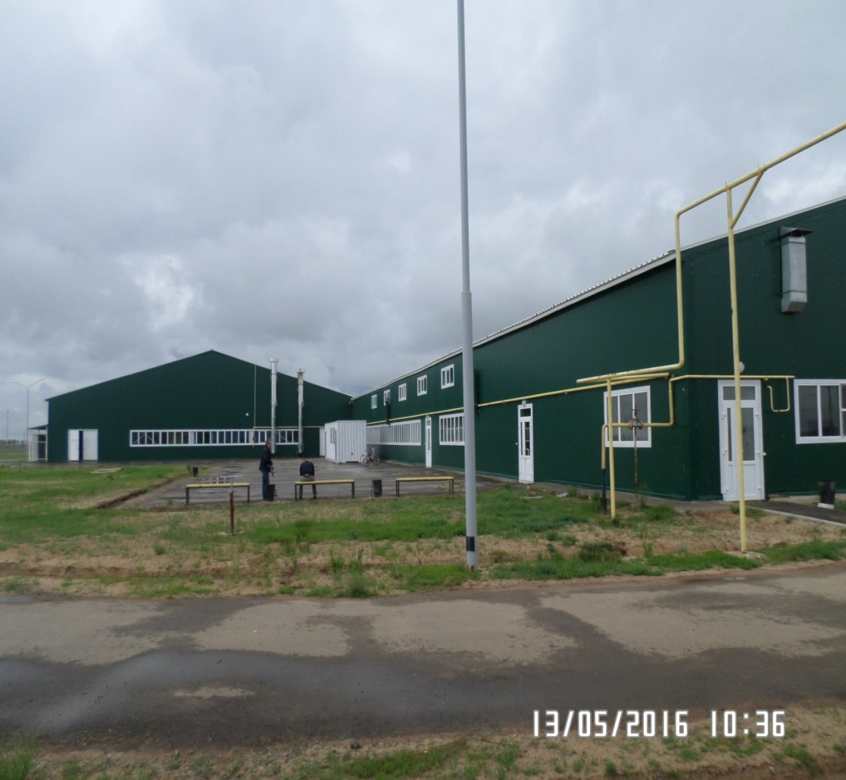
Experience in managing large projects
Bank protection in the village Oblivka, Burlinsky district, WKO | The slaughter shop for the MRS along the Uralsk-Atyrau highway at the intersection of the Chapaevo-Zhangala highway, WKO

Slide 33
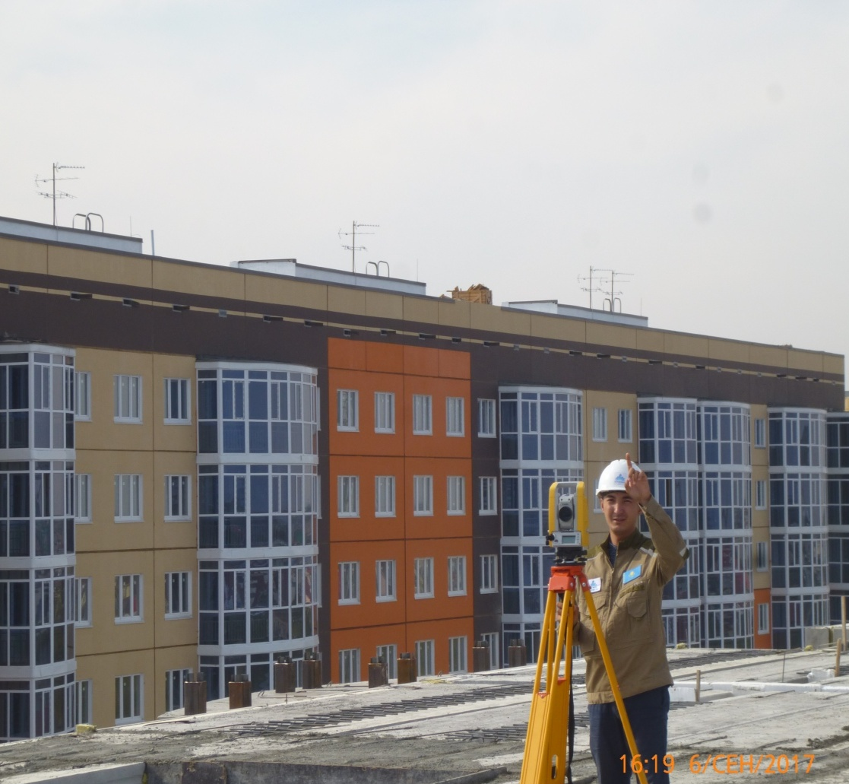
Experience in managing large projects
Construction of a 9-storey 180-apartment 4-porch large-panel apartment house between the Uralsk-Atyrau and Uralsk-Saratov, Uralsk, ZKOs. Site number 5

Slide 34
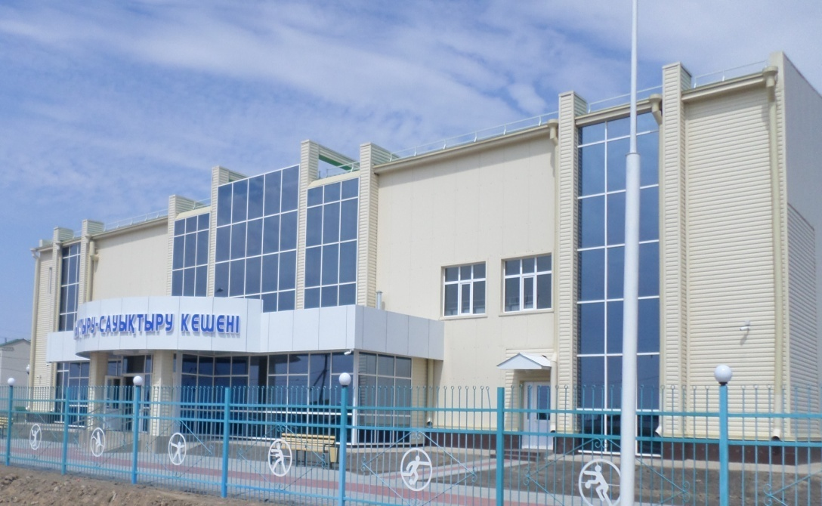
Experience in managing large projects
Construction of a sports and recreation complex for 160 spectators in the village of Zhympity | Construction of a kindergarten for 360 places in the village of Zachagansk, Uralsk, WKO

Slide 35
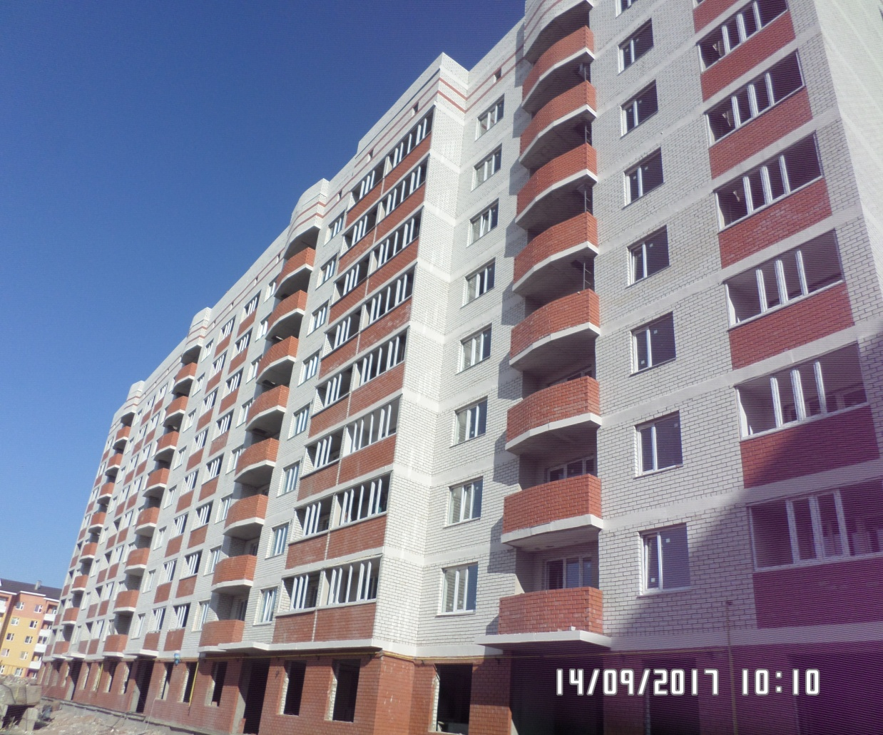
Experience in managing large projects
Complex of 10-9-storey residential buildings Site No. 33 in the PPD of multi-storey building between the Uralsk-Atyrau and Uralsk-Saratov routes in Uralsk, VKO

Slide 36
Experience in managing large projects
Construction of a culture center for 300 places in the village Podstepnoe of Terektinsky district, WKO | A multi-storey residential building in the village of Zachagansk. site number 9 in Uralsk, WKO

Slide 37
Experience in managing large projects
Construction of Zhangalinsky group water supply in Zhangalinsky district, WKO

Slide 38
Experience in managing large projects
Construction of Zhangalinsky group water supply in Zhangalinsky district, WKO

Slide 39
Experience in managing large projects
Hydro treating section of diesel fuel components, Aksai, WKO | Addition to the administrative building of the Department of Internal Affairs WKO (adjustment)

Slide 40
Experience in managing large projects
Construction of a specialized service center in Atyrau

Slide 41
Our customers
Trust of customers is reliable evidence of
high quality of our work.
- RSI "Committee on Water Resources of the Ministry of Agriculture" - SI "Construction Management WKO" - SI "Construction Department of Uralsk" - SI "Office of Passenger Transport and Highways" - SI "Department of Architecture, Urban Construction and Construction of Bokeyorda District" - GU "Zhangalinsky district department of education | - SI "Construction Management of Atyrau region" - SI "Akzhaiksky District Department of Housing and Communal Services, Passenger Transport and Highways" - Condensate JSC - Zhaikmunai LLP - Ural Petrochemical Company LLP - Kazmontazhservis LLP - Ural-Krov-Avto LLP - KazTransoil JSC | - Ural Oil and Gas LLP - ORLI A.Z. LLP - Business-Region LLP - Kubley LLP - ALEM GROUP KAZAKHSTAN LLP - Grand Oil LLP - Taukel LLP - Gazstroy Yug LLP - Zhayyk Agro LTD LLP - KazSaudaShina LLP - Ali Word Company LLP - KEGOC JSC
It is really important for us that our partners succeed together with us!

Slide 42
Recommendations

Slide 43
Zhana Consulting LTD LLP
Thanks for
attention!
55 Sarayshyk street , 090000 Uralsk, RoK, office 114
Tel .: +7 (7112) 50-96-70,
50-97-66, 24-32-41
E-mail: zhana.consulting@mail.ru
Site: zhanaconsulting.kz

